Slide 1

Introduction to Python
Data Analysis In SPORTS AND EXERCISE SCIENCE

Slide 2
Outline of the course
Introduction to python
Basic operators
Libraries in python and their installation
Python data structure
Control flow & loops

Slide 3
What is Python
Python is a high-level, general-purpose and a very popular programming language.
Python programming language (latest Python 3) is being used in web development, Machine Learning applications, along with all cutting edge technology in Software Industry.

Slide 4
Why learn Python
Designed for clear, logical code that is easy to read and learn.
There are lot of libraries and frameworks written in python allowing users to apply Python in wide variety of tasks.
Great documentation online
https://docs.python.org/3/

Slide 5
Installation of Python
Download Anaconda distribution from https://www.anaconda.com/products/distribution.
For this course we will work on Jupyter Notebook.
Refer to the following links for installation steps for different OS:
https://docs.anaconda.com/anaconda/install/windows/ (WINDOWS)
https://docs.anaconda.com/anaconda/install/mac-os/ (MAC)
https://docs.anaconda.com/anaconda/install/linux/ (LINUX)

Slide 6
Basic operators in python
Arithmetic Operators
Comparison (Relational) Operators
Assignment Operators
Logical Operators

Slide 7
Arithmetic operators
Operator | Description | Syntax
+ | Addition: adds two operands | x + y
– | Subtraction: subtracts two operands | x – y
* | Multiplication: multiplies two operands | x * y
/ | Division (float): divides the first operand by the second | x / y
// | Division (floor): divides the first operand by the second | x // y
% | Modulus: returns the remainder when the first operand is divided by the second | x % y
** | Power: Returns first raised to power second | x ** y

Slide 8
Comparison (Relational) Operators
Operator | Description | Syntax
> | Greater than: True if the left operand is greater than the right | x > y
< | Less than: True if the left operand is less than the right | x < y
== | Equal to: True if both operands are equal | x == y
!= | Not equal to – True if operands are not equal | x != y
>= | Greater than or equal to True if the left operand is greater than or equal to the right | x >= y
<= | Less than or equal to True if the left operand is less than or equal to the right | x <= y

Slide 9
Assignment Operators
Operator | Description | Syntax
= | Assign value of right side of expression to left side operand | x = y + z
+= | Add AND: Add right-side operand with left side operand and then assign to left operand | a+=b a=a+b
-= | Subtract AND: Subtract right operand from left operand and then assign to left operand | a-=b a=a-b
*= | Multiply AND: Multiply right operand with left operand and then assign to left operand | a*=b a=a*b
/= | Divide AND: Divide left operand with right operand and then assign to left operand | a/=b a=a/b
%= | Modulus AND: Takes modulus using left and right operands and assign the result to left operand | a%=b a=a%b
//= | Divide(floor) AND: Divide left operand with right operand and then assign the value(floor) to left operand | a//=b a=a//b
**= | Exponent AND: Calculate exponent(raise power) value using operands and assign value to left operand | a**=b a=a**b

Slide 10
Logical Operators
Operator | Description | Syntax
and | Logical AND: True if both the operands are true | x and y
or | Logical OR: True if either of the operands is true | x or y
not | Logical NOT: True if the operand is false | not x

Slide 11
Libraries for data analytics
Numpy
Pandas
Matplotlib
Scipy
Scikit-learn

Slide 12
Installation of libraries
Open anaconda navigator
Go to Environments-> in Search packages enter the library to be installed.
Go on and install the required libraries
OR
Open anaconda prompt-> enter command “conda install pandas” or “pip install pandas”
Pip and conda are package manager for any software (installation, upgrade and uninstallation)

Slide 13
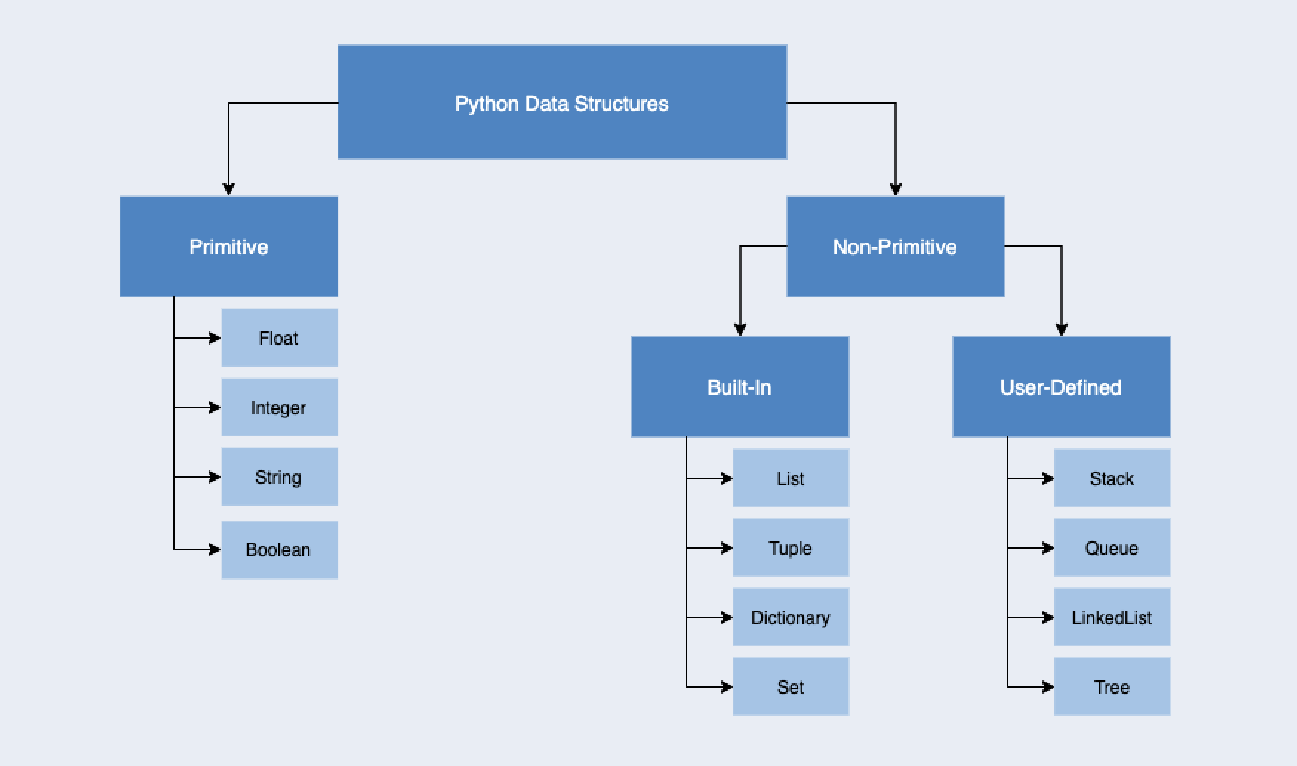
Python data structures
Source:https://miro.medium.com/max/2190/1*2JFd94q0vzsEcr-LB-220g.png

Slide 14
1. Numbers(int, float)
Types of Numbers in Python :Integer and float
Integers are whole numbers, positive or negative ex: +4,-7,9 etc
Float have a decimal point in them, or use an exponential (e) to define the number. Ex: 1.2,-0.5
Basic Arithmetic
Variable Assignment in Python

Slide 15
Variable name creating rules
Names can not start with a number.
There can be no spaces in the name, use _ instead. Can't use any of these symbols :'",<>/?|\()!@#$%^&*~-+
It's considered best practice that names are lowercase.
Avoid using the characters 'l' , 'O' , or 'I' as single character variable names.
Avoid using words that have special meaning in Python like "list" and "str"

Slide 16
2. String
Strings are sequence of character, using the syntax of either single quotes or double quotes.
Ex: “Hello” ,“I didn’t had coffee.”
Creating Strings
Printing Strings
String Indexing and Slicing
String Properties
String Methods
Print Formatting
H | e | l | l | o
0(0) | 1(-4) | 2(-3) | 3(-2) | 4(-1)

Slide 17
3. Lists
Lists are ordered sequences that can hold variety of object types.
They use [] bracket and comma to separate objects. Ex:[1,2,3,4,5]
Creating lists
Indexing and Slicing Lists
Basic List Methods

Slide 18
4. Dictionaries
Dictionaries are unordered mapping for storing objects. In lists its ordered sequence, dictionaries have key-value pairing.
Key-value pair allows users to grab objects quickly without the need to know the index location.
Uses curly braces and colons to signify the keys and the associated values.
{‘key1’:’value1’,’key2’:’value2’}
Constructing a Dictionary
Accessing objects from a dictionary
Basic Dictionary Methods

Slide 19
When to use list/dictionary
Dictionaries: Object is retrieved by key name.
Unordered and cannot be sorted.
Lists: Objects retrieved by location
Ordered sequence and can be indexed or sliced.

Slide 20
5. Tuples
Tuples are very similar to lists. However, they have one key difference that is immutability. Once an element is inside the tuple it cannot be re-assigned.
Tuple uses parenthesis: (1,2,3)
Constructing Tuples
Basic Tuple Methods
Immutability
When to use Tuples

Slide 21
6. Control flow
When we want to execute certain piece of code when certain condition has been met. For ex: if my cat is hungry(condition), I will feed my cat(action).
Control flow syntax makes use of colons and identation (whitespace).
If
elif
else
For loop
While loop

Slide 22
Syntax of different control flows
if | if some_condition #execute some code
if/else | if some_condition #execute some code else: #do something else
if/elif/else | if some_condition #execute some code elif some_other_condition #execute something different else: #do something else
for | my_lists=[1,2,3] for item_name in my_lists print(item_name)
while | while some_Boolean_condition #do_something

